Slide 1
Final Project Conv Accelerator
林廉恩 洪子茵 陳永真

Slide 2
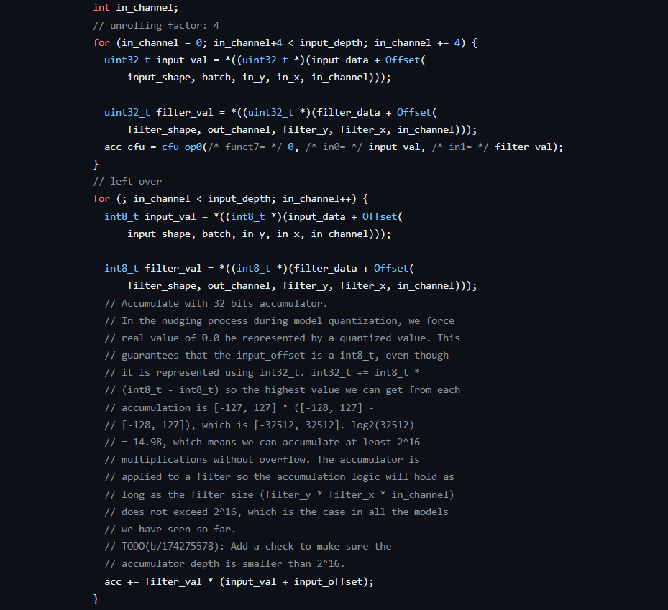
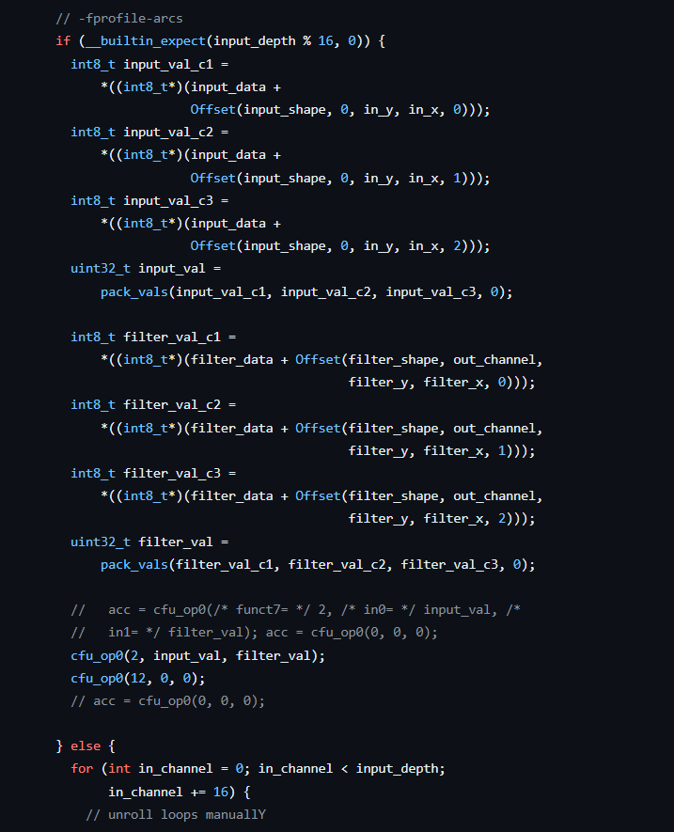
Software Level Optimizations
update algorithm: * if-else condition based on runtime / model * only the first conv layer with input_depth = 3, while the others are 16x * set expect to 0 and let compiler optimizes the runtime branch
Improve cache hits (minor): * recast alignas(64) to meet cache line size
* branch TA_SIMD
* our design

Slide 3
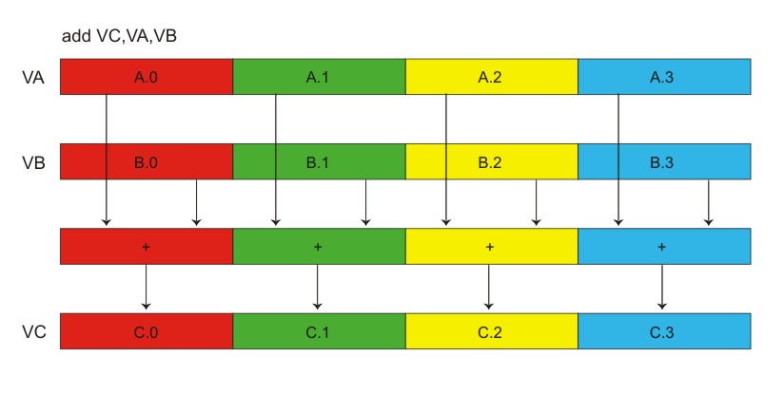
Hardware Level Optimizations – upscaled SIMD
cmd_payload_inputs
Upscale to 16x
buffer size : 128 bits
Outputs 32 bits SOP accumulato
reg bufferA
reg bufferB
SIMD_16x
SIMD_4x
SIMD_4x
Problems : * data to feed buffer takes time
* the accelerator is idle most of the time
sol. => increase cpu-cfu data bandwidth (TBU)
SIMD_4x
SIMD_4x
SIMD_4x
* originally
* similar performance to SIMD_8x => IO bound

Slide 4
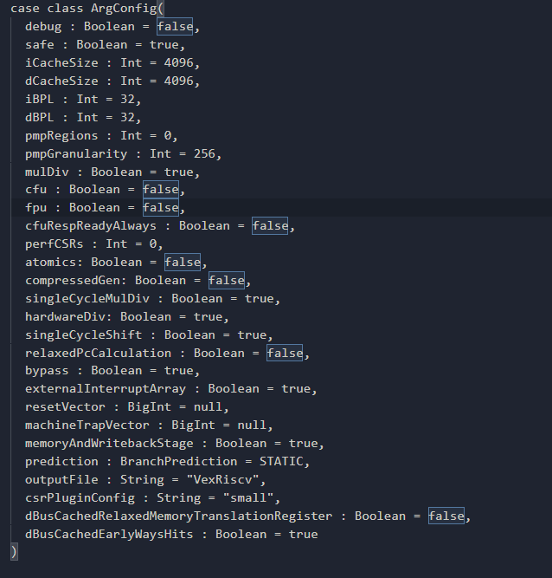
Hardware Level Optimizations – CPU
Increase cpu cache size (D$ / I$)
Change branch prediction to dynamic
EXTRA_LITEX_ARGS="--cpu-variant=generate+csrPluginConfig:all+cfu+iCacheSize:8192+dCacheSize:8192+prediction:dynamic"
* Original cpu : I$ / D$ size = 4096 with static prediction

Slide 5
Compiler Level Optimizations
GCC flags : * Ofast = O3, fast-math, allow-store-data-races, no-protect-parens * inline * unroll-loops (intense instruction cache miss) -> unroll loops manually on small loops
Branch prediction: * __builtin_expect() : * gcov tools * -fprofile-arcs & -ftest-coverage to check coverages
Attributes : * __attribute__((always_inline)) on conv * override compiler’s discretion (normal inline) * reduce function call overheads * free stack memory / function AR * __attribute__((hot)) but neglect optimizations (O3)

Slide 6
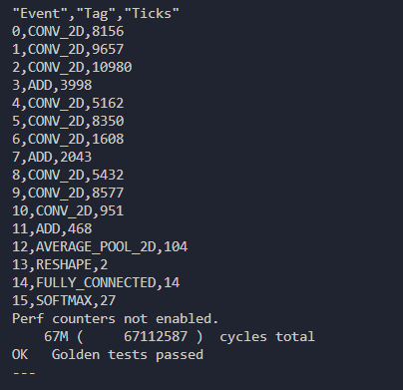
Evaluation
Acc : 0.875 Latency : 897387.355 us
* last layer

Slide 7
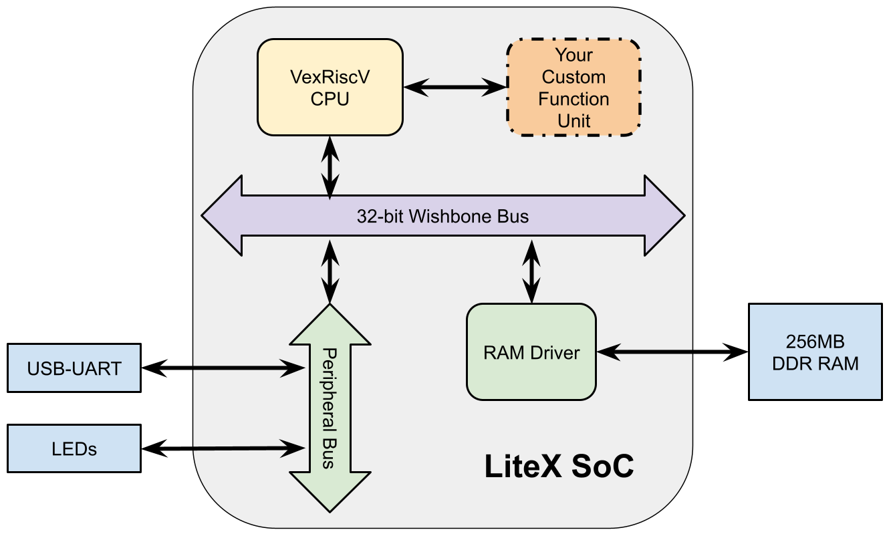
What we tried & further improvements
acc
We tried : __attribute__((vector_size()))
software level SIMD
Low performance compared to intrinsic SIMD
TODO : Post Processor
Offload post processing to hardware
TODO: Increase data bandwidth to CFU
Bus modifications
Bias
Post Processing Pipeline
Shift
Offset
output

